Slide 1
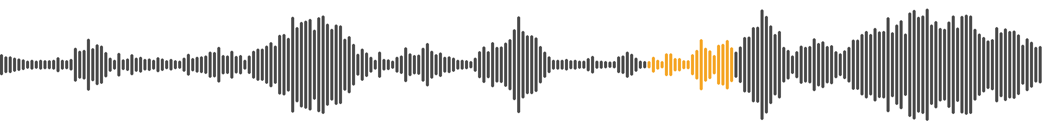
Starting Practice, Together
Helping band members start practicing the feedback they receive
2026 Challenge 6 · Learning Communication
Notes:
Intro (30s). We build for bands: after rehearsal, how do players actually start practicing the feedback they got?

Slide 2
Our Team
Nickname
Nickname
Role
Role
Nickname
Nickname
Nickname
Role
Role
Role
Notes:
Introduce each member by nickname and role (replace the placeholders and drop in photos).

Slide 3
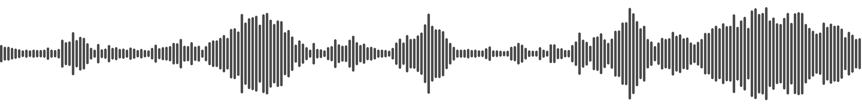
Story & Context
Together
Shows go well when the band rehearses together a lot.
In between
Solo practice isn’t only your own part — it’s the places where you must lock in with the other sessions.
What worked
Before a show, only the drums were recorded at rehearsal. Practicing while listening to just that worked well.
Notes:
Story 1/2 (1 min). Shows go well with lots of joint rehearsal. Between rehearsals, solo practice means locking in with other sessions. Example: a drums-only recording helped.

Slide 4
Story & Context
Feedback and recordings are scattered across chat apps like KakaoTalk — and everyone remembers it differently.
Full-band recording
Section clips
Per-session recordings
Which one is the latest?
“Bass — rushing around 1:20”
Who said what?
So practice never starts, and feedback begins to feel like homework.
Notes:
Story 2/2 (1 min). Today the feedback, full recordings, per-session files and section clips are scattered in chat; memories differ, so it is hard to begin.

Slide 5
Target Use Case
User
Amateur band members who receive feedback from their bandmates
Moment
Right after a rehearsal — practicing alone, on their own instrument
Pain Point
Feedback is detached from the sound. It is hard to find the exact moment, and hard to know where to begin.
Notes:
Target (1 min). Who: band members. Pain: no link between the note and the sound, no obvious first step.

Slide 6
Challenge Response
GUIDING QUESTION
How might we help band members start practicing the feedback they receive?
OUR RESPONSE
An iPad app that separates a rehearsal recording into instrument tracks, pins each piece of feedback to its exact moment, and turns it into a short, game-like practice.
Pinned to the sound
Two takes at most
Play, not homework
Notes:
Response (1 min). Three ideas: feedback lives on the sound; max two takes so it never feels endless; game-like but never competitive.

Slide 7
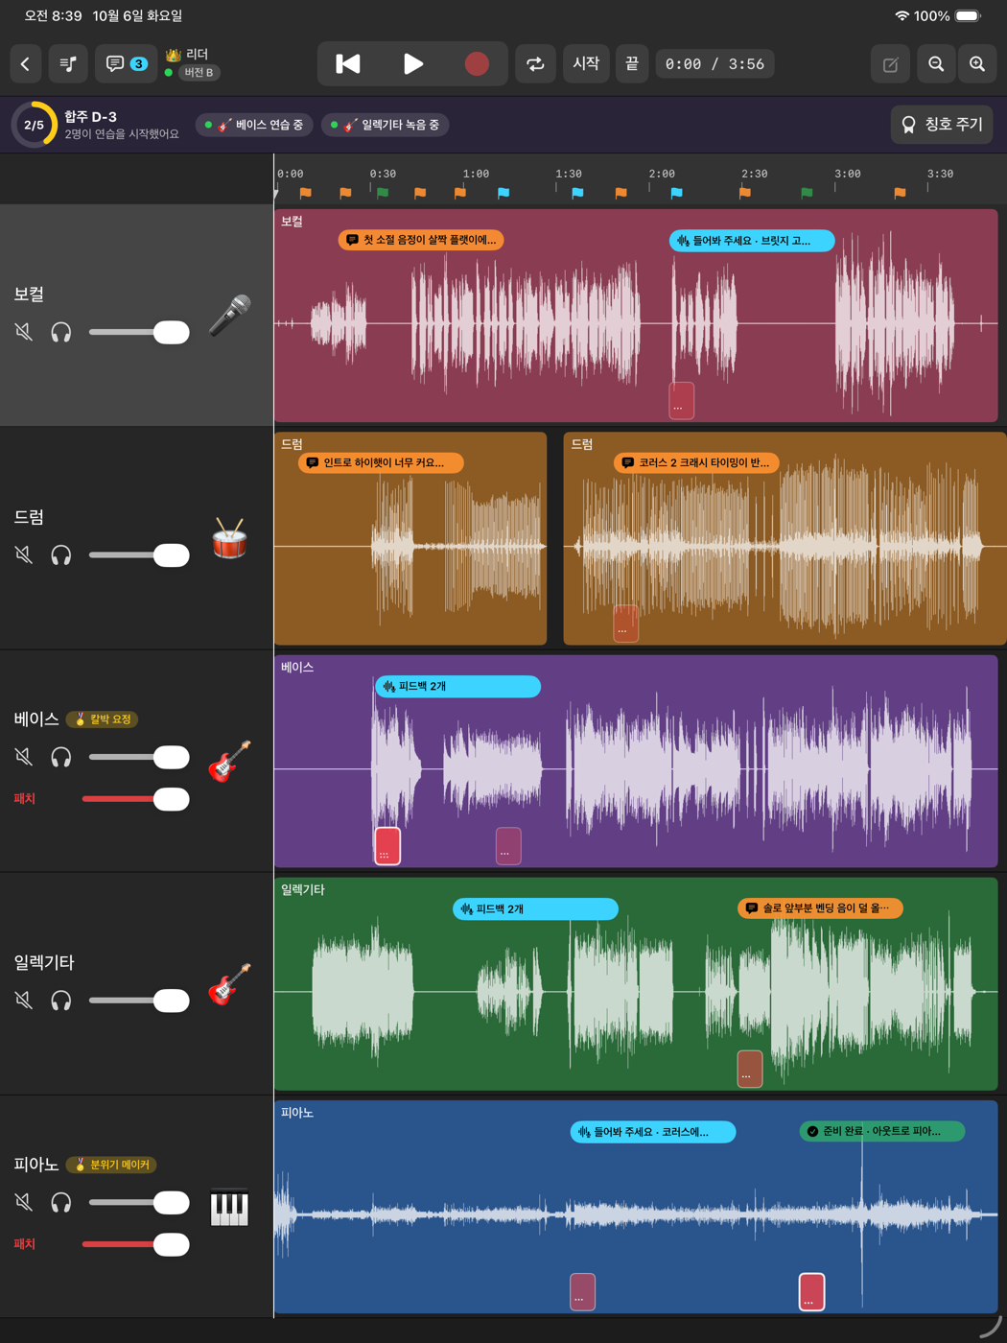
1. Feedback lives on the sound
Lo-Fi Prototype (Flow)
The rehearsal is split into one track per instrument. Each note from a bandmate is pinned to the exact section on that player’s track — tap it to loop just that moment.
Notes:
Flow 1 (1 min). Separated tracks (vocal, drums, bass, guitar, piano); markers show feedback and its status.

Slide 8
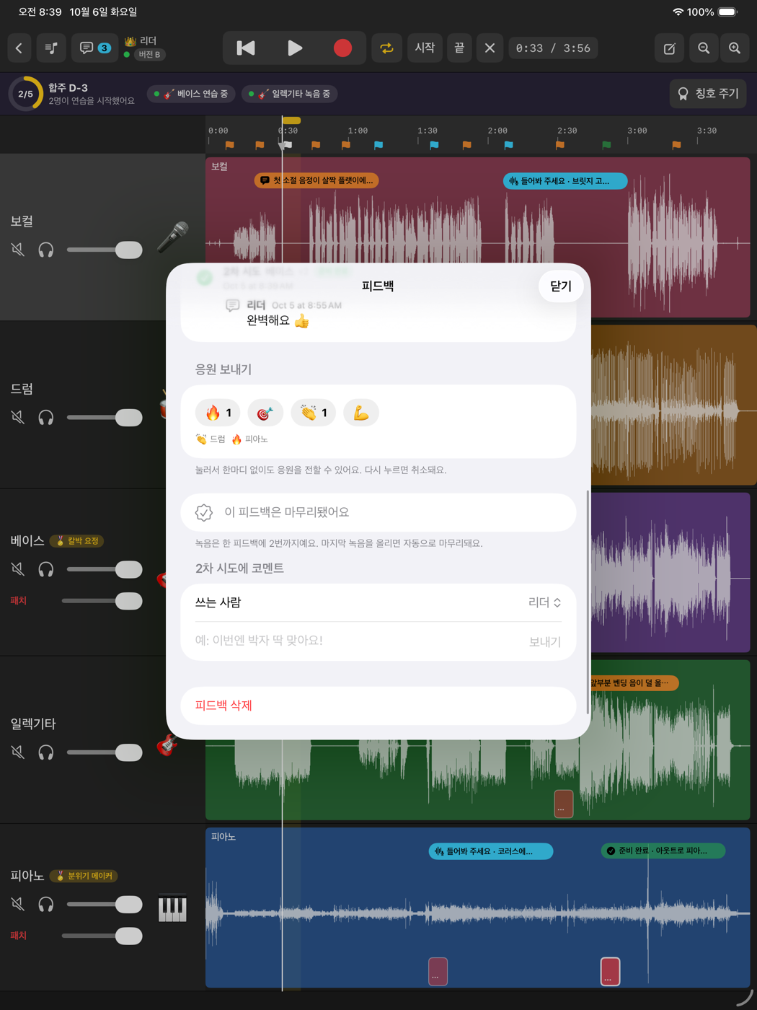
2. Two takes, then done
Lo-Fi Prototype (Flow)
Re-record only that section — at most two takes. Bandmates answer with a short comment or a one-tap cheer, and the last take is added to the song automatically.
Notes:
Flow 2 (1 min). The two-take limit keeps it light; cheers need no words. (App UI is in Korean in this prototype.)

Slide 9
3. A gentle way in
Lo-Fi Prototype (Flow)
Tempo ladder
100%
85%
Tap “Try it” and a four-beat count-in starts. The section loops slowly at first, then speeds up to full tempo — the pitch never changes. Not sure where to begin? Draw today’s section.
70%
1 2 3 4
count-in
2 loops
2 loops
1 loop
Notes:
Flow 3 (1 min). Count-in, then 70% x2, 85% x2, 100% x1 loops of the same section. Tempo changes without changing pitch.

Slide 10
Learning Questions
1
Which game element helps people start practicing without turning it into competition?
2
Could Apple’s Music Understanding framework (beats and bars) pin feedback to bars automatically — and how accurate is it on noisy band recordings?
Notes:
Close (30s). Two questions for the mentors; research and insight Q&A follows.

